Slide 1

MA Department of Public Health Accessible Print Materials and
Formatting Guidelines
Developed in partnership with the Institute for Human Centered Design 2023

Slide 2
Accessible Elements for Print Materials
Introduction 3
Content 4
Design Layout 9
Graphic Design 12
Use of Images 27
Resources 30
Prepared by the Institute for Human Centered Design for the Massachusetts Department of Public Health

Slide 3
Materials should be designed for diverse audiences, including people with disabilities. The Massachusetts Department of Public Health (DPH) in adherence with the Americans with Disabilities Act (ADA) requires that people with disabilities have communication access that is equally effective as that provided to people without disabilities.
These guidelines contain DPH policies, recommended standards, and website resources for accessible design and print information. Additional resources for alternative communication services, such as having print material produced in braille, are also included.
Accessible Print Materials
IHCDesign.org

Slide 4
Overview
Materials should reflect the target audience. Materials should be culturally and linguistically appropriate.
The target population should include people with disabilities.
Materials should identify disability as a risk factor for health conditions where appropriate.
During all phases of the material development process, including initial discussions, concept testing, and focus groups, the target audience sample should include people with disabilities.
Content
Prepared by the Institute for Human Centered Design for the Massachusetts Department of Public Health

Slide 5
Plain Language
What are the most common techniques that can help you achieve this goal? PlainLanguage.gov
Active voice, not passive
Short sentences and paragraphs
Common, everyday words
“You” and “We” and other pronouns
Additional Resources:
Checklists and handouts
Plain writing page template
Writing guidelines
Content

Slide 6
Translation
Culturally and Linguistically Appropriate Services (CLAS)
The Culturally and Linguistically Appropriate Services (CLAS) standards were developed to provide guidance on how to improve service delivery to clients who may not have sufficient access to care based on race, ethnicity, linguistic capacity, or cultural background. mass.gov/service-details/clas-national-standards
When creating accessible materials, provide easy-to-understand print and multimedia materials and signage in the languages commonly used by the populations in the service area.
mass.gov/doc/clas-introduction/download
Content

Slide 7
Making Print Material Accessible for People Who Use Screen-Reading Software*
Use built-in headings and styles — To preserve tab order and to make it easier for screen readers to read your documents, use a logical heading order and the built-in formatting tools in Word.
Include alt text with all visuals — Elements, such as a graphics, images, charts or photos need to be described. Alt text helps people who can’t see the screen to understand what’s important in images and other visuals.
Ensure that color is not the only means of conveying information — People who are blind, have low vision, or are colorblind might miss out on the meaning conveyed by particular colors.
*Screen-reading software allows people who are blind to access content with a voice synthesizer or braille display.
Content

Slide 8


Print Meeting Materials
Make sure that:
Notices and invitations include information concerning accessibility provided.
If you’re holding the event in an accessible space, use the symbol for wheelchair accessibility.
If there will be sign language interpreters, use the sign language interpretation symbol.
The Graphic Artist Guild has all the access symbols at graphicartistsguild.org/downloadable-disability-access-symbols.
Provide an opportunity for people with disabilities to request accommodations they need to participate. You can have a fill-in space on a registration form, but we recommend that you also provide an individual name and contact information for privacy reasons.
Content

Slide 9
Page Format
Make sure that:
Outside page margins are at least 1/2 inch.
The gutter margins (the adjoining margins in two facing pages) is at least 7/8 inch if the document is going to be bound or three hole punched.
The space between columns is at least 1/2 inch.
Design Layout

Slide 10
Visual Hierarchy
Considerations on content organization*:
Guide the eye to critical information through a visual hierarchy.
Keep it simple. If there are too many elements fighting for space within the message, information is lost.
Don’t use too many visual elements (for example pictures, decorative fonts or colors).
The headline is the piece of information that most viewers will read first so the headline should be clear, concise and accurately represent the content of the message.
Make sure that what you add enhances the message and does not distract from it.
Design Layout
*ithelp.brown.edu/custom-images/files/Brown_BestPractices_Final_7.22.15%20%20.pdf

Slide 11
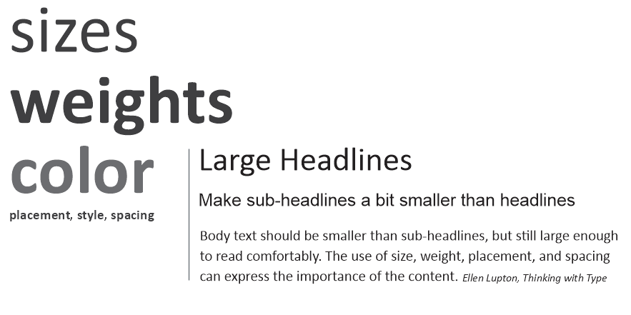
Visual Hierarchy
Design Layout
Hierarchy can be emphasized graphically and is a critical element that allows readers to discern the importance of content and allows them to scan and absorb information quicker.

Slide 12
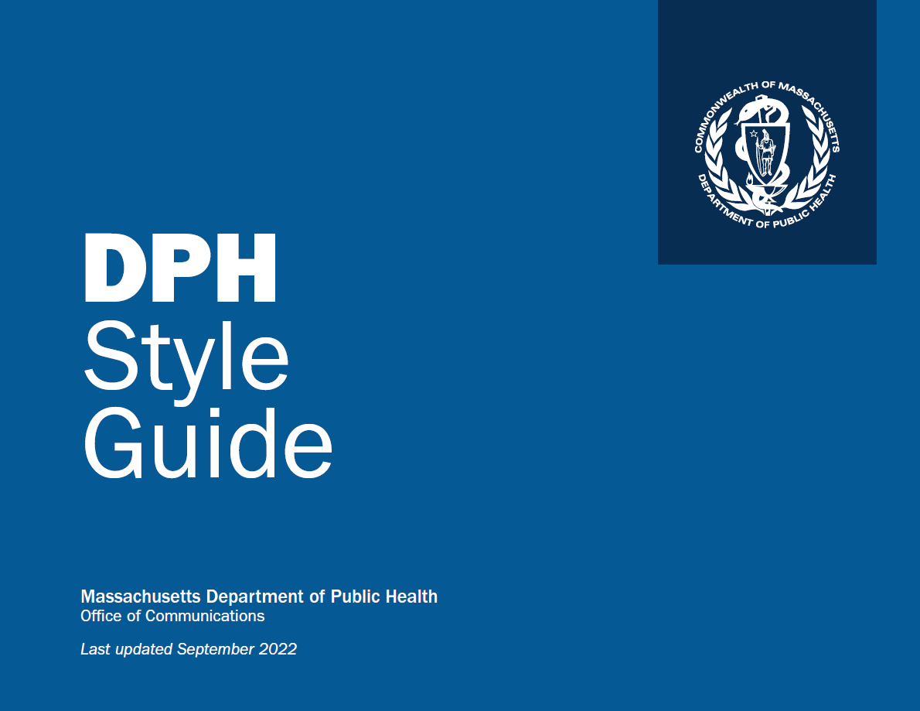
DPH Style Guide
If you are developing a document on behalf of the Department of Public Health, refer to the DPH Style Guide [tinyurl.com/DPHStyleGuide] for specific design, color, and font choices.
Graphic Design

Slide 13
Color and Contrast
Poor color contrast:
The Institute for Human Centered Design (IHCD) is an international education and design non-profit organization committed to advancing the role of design in expanding
Better color contrast:
The Institute for Human Centered Design (IHCD) is an international education and design non-profit organization committed to advancing the role of design in expanding
Graphic Design
Ensure there is sufficient contrast and color difference between text and background colors.
  Text contrast should be 4.5:1 for regular text (less than 18 pt) or 3:1 for large text (more than 18 pt or 14 pt bold). Contrast checkers can be used to confirm that color choices meet contrast minimums:
  tpgi.com/color-contrast-checker
Icons and other graphics should have a contrast ratio of at least 3:1 with the background.

Slide 14
Color and Contrast continued
More Effective Contrast
Effective Contrast
Less Effective Contrast
The stark contrast of black on white can sometimes create eye strain for readers. If using a solid black, it can be addressed by toning down the white background to a subtle color.
Graphic Design
Reversing text out can also help with legibility but ensuring proper contrast is critical.
Avoiding a stark contrast between light text and dark background also applies. Light on dark will halo letters due to glare. In this sample the background is 70% black and text is 10% black.

Slide 15

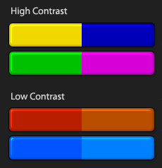
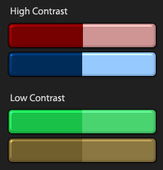
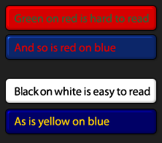
Color and Contrast continued
Contrast of Hue:
Contrast of hue is what relates most directly to the color wheel combinations. The further away from each other two colors are, the better the contrast.
https://webaim.org/resources/contrastchecker/
Graphic Design
Contrast of Tint and Shade:
Contrast of value is very efficient in creating large contrasts.
Colors and Text:
Using the right contrast is especially important for text. Using the wrong colors can decrease the readability drastically, and it will quickly tire the reader's eyes.

Slide 16
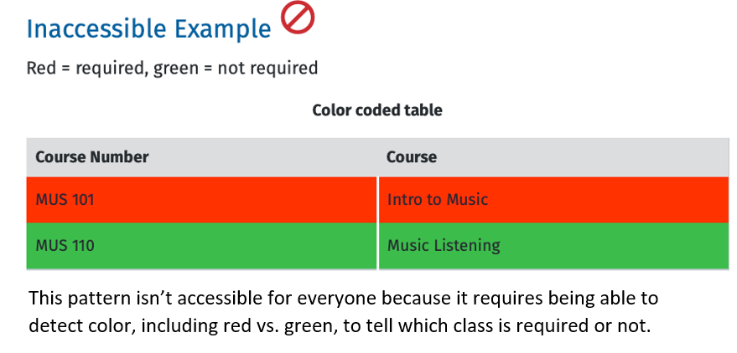
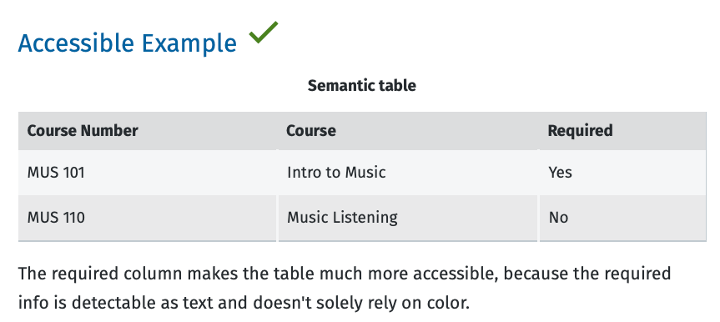
Color and Contrast continued
Avoid using color to color code or as the only way to convey information: reds and greens, in particular, are difficult to differentiate from each other for people with color vision deficiency.
  Provide redundant information with shapes, textures, and other cues in addition to colors.
Graphic Design

Slide 17
Font/Typeface Choice
Sans serif fonts are easier to read. Because the simple letter shapes make them more recognizable, they have a slightly higher readability.
Arial, Verdana, Calibri, and Helvetica are sans serif fonts that have more readability.
Graphic Design
Sans Serif
Serif
Serif fonts have small decorative lines attached to the tops and bottoms of the letters. In a large point size they can be legible; however, when used in a digital environment with smaller point sizes or bold face they often become difficult to read. Serif fonts that are common are Times New Roman, Palatino, and Georgia.

Slide 18
Font/Typeface Choice continued
Graphic Design
Select a font that when bolded is not so bold that letters begin to close up. The smaller the font the more critical this becomes.
This font is too bold. Select a font that when bolded is not so bold that letters begin to close up. The smaller the font the more critical this becomes.
Be careful when bolding a font. Ensure that when the font is bold the letters’ counters don’t close — the small spaces of e, a, g, c, etc. This will render them illegible for some readers.

Slide 19
Font/Typeface Choice continued
Graphic Design
Upper- and lowercase
letters are generally
more legible than all
uppercase letters.
All UPPER- AND LOWERCASE LETTERS ARE NOT LEGIBLE, ESPECIALLY WHEN USED FOR MULTIPLE WORDS OR PARAGRAPHS.
Keep uppercase (block capitals) to a minimum and only for words that are familiar. Readers rely on the ability to discern the ascenders and descenders of letters to read words. (i.e., b, d, g, p, etc.)
Uppercase should be limited to titles; large blocks of uppercase text are hard to read.

Slide 20

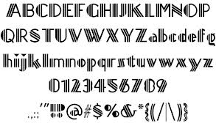
Font/Typeface Choice continued
Extra thin, extra black, italic, and condensed fonts are less legible.
San serif type can be more legible based on the font choice.
When using italic ensure that it is a simple, clean font and an appropriate size.
Graphic Design
Avoid the use of display fonts and decorative fonts that have distinct variations. If they must be used, the content should always be repeated within body content.

Slide 21
Font/Typeface Choice continued
Avoid the use of Roman numerals, as they can be perceived as letters and not numbers.
(I., II., III., IV. or i., ii., iii., iv. etc.)
Use Arabic numbers instead.
(1, 2, 3, 4, etc.)
Graphic Design
Arabic numbers are easier to read and do not blend in with text. When using numbers ensure that the typeface, type size and type weight do not make numbers such as 3, 5, 6, 8, 9 look the same.

Slide 22
Text Alignment
Centered: Materials should be designed for diverse audiences, including people with disabilities. The Massachusetts Department of Public Health (DPH) in adherence with the Americans with Disabilities Act (ADA) requires that people with disabilities have communication access that is equally effective as that provided to people without disabilities.
Avoid centered text for body copy as it makes it difficult to track back to the start of the next line.
Graphic Design
Justified Text: Materials should be designed for diverse audiences, including people with disabilities. The Massachusetts Department of Public Health (DPH) in adherence with the Americans with Disabilities Act (ADA) requires that people with disabilities have communication
Avoid justified text that creates uneven word spacing and makes it difficult for the eye to track across the line.
Right-Aligned: Materials should be designed for diverse audiences, including people with disabilities. The Massachusetts Department of Public Health (DPH) in adherence with the Americans with Disabilities Act (ADA) requires that people with disabilities have communication
Avoid right-aligned text. As noted above, uneven left edge body copy makes it difficult to find the start of the next line.

Slide 23
Text Alignment continued
Left-Aligned: Materials should be designed for diverse audiences, including people with disabilities. The Massachusetts Department of Public Health (DPH) in adherence with the Americans with Disabilities Act (ADA) requires that people with disabilities have communication access that is equally effective as that provided to people without disabilities. These guidelines contain DPH policies, recommended standards, and websites resources for accessible
Graphic Design
Always use left-aligned text for body paragraphs. Keep your eye out for poor line breaks and avoid hyphenation.

Slide 24
Line Length
Not long enough: Materials should be designed for diverse audiences, including people with disabilities. The Massachusetts Department of Public Health (DPH) in adherence with the Americans with Disabilities Act (ADA) requires that people with disabilities have communication access that is equally effective as that provided to people without DPH
Better: Materials should be designed for diverse audiences, including people with disabilities. The Massachusetts Department of Public Health (DPH) in adherence with the Americans with Disabilities Act (ADA) requires that people with disabilities have communication access that is equally effective as that provided to people without disabilities. These guidelines contain DPH policies, recommended
Graphic Design
Always use left-aligned text for body paragraphs. Avoid using short lines.
Be sure to always keep your eye out for poor line breaks and overused hyphenation.

Slide 25
Line Spacing
Too much line spacing: Materials should be designed for diverse audiences, including people with disabilities. The Massachusetts Department of Public Health (DPH) in adherence with the Americans with Disabilities Act (ADA) requires that people with disabilities have
Additional space between lines can make it easier to read and therefore understand the content; however, too much space will make it harder.
And too little space will also make it difficult.
Graphic Design
Too little line spacing: Materials should be designed for diverse audiences, including people with disabilities. The Massachusetts Department of Public Health (DPH) in adherence with the Americans with Disabilities Act (ADA) requires that people with disabilities have communication access that is equally effective as that provided to people without disabilities. These guidelines contain DPH
More effective line spacing: Materials should be designed for diverse audiences, including people with disabilities. The Massachusetts Department of Public Health (DPH) in adherence with the Americans with Disabilities Act (ADA) requires that people with disabilities have communication access that is equally effective as that provided to people

Slide 26
Letter and Word Spacing
Tight Spacing: Materials should be designed for diverse audiences, including people with disabilities. The Massachusetts Department of Public Health (DPH) in adherence with the Americans with Disabilities Act (ADA) requires that people with disabilities have communication access that is equally effective as that provided to
Beware of tightening word and letter spacing to fit body copy. Consider using a different font or font size first.
When characters are too tight, the letters merge together, creating shapes that are unrecognizable. The lack of word space will cause the reader to read much slower. This could present problems if text content is timed on the digital sign.
Graphic Design
Untouched: Materials should be designed for diverse audiences, including people with disabilities. The Massachusetts Department of Public Health (DPH) in adherence with the Americans with Disabilities Act (ADA) requires that people with disabilities have communication access that is equally effective as that provided to people without disabilities. These guidelines

Slide 27
Images
Health promotion materials should use images representing the target population, including people with disabilities. Images should have sufficient resolution and significant color contrast for easy viewing.
Make sure that:
Alt text is available for all images and graphics perkins.org/resource/how-write-alt-text-and-image-descriptions-visually-impaired
Labels are used for each image, and an appropriate font size is used. Ideally 12 point sans serif, although often different fonts can vary in size and appear larger or smaller
Line drawings or floor plans are clear and bold, with limited detail and a and an appropriate font size
Use of Images

Slide 28

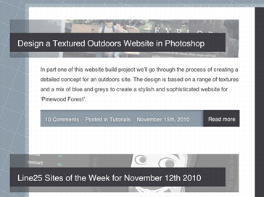

Images and Legibility
Avoid printing text on image backgrounds (overprinting). Overprinting negatively impacts legibility and interferes with the contrast between the text and background. Text should be set against a solid background.
Use of Images
Ensure that when you overlay text on an image or pattern that the text remains legible and the contrast is strong.
Moving the text to a solid portion of the image or adding a transparent or solid bar behind the text will assist with legibility.

Slide 29
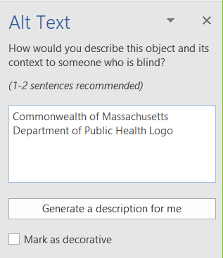
Images and Alt Text
Use of Images
Ensure that each graphic, image, chart, or photo has alt text. This can be done by right-clicking on the element and selecting “Edit Alt Text” or “View Alt Text,” and this feature will appear on your screen.

Slide 30
Resources
Plain Language
plainlanguage.gov
Alt Text
perkins.org/resource/how-write-alt-text-and-image-descriptions-visually-impaired
Color Contrast Checker
tpgi.com/color-contrast-checker
Screen Readers
Make Your Word Documents Accessible to People with Disabilities
Make Your PowerPoint Presentations Accessible to People with Disabilities
Make Your Excel Documents Accessible to People with Disabilities
Culturally and Linguistically Appropriate Services (CLAS)
mass.gov/service-details/clas-national-standards
mass.gov/doc/clas-introduction/download
Resources

